Slide 1

Statistical Approaches for Entity Resolution under Uncertainty
PhD Completion Seminar
Neil Marchant
School of Computing and Information Systems, University of Melbourne
22 July 2020
Supervisors: Ben Rubinstein (principal), Rebecca Steorts (external), Aurore Delaigle
U.S. Census Bureau DRB No: CBDRB-FY20-309

Slide 2
Seminar overview
Background and motivation
Research focus
Summary of key contributions:
Scalable unsupervised Bayesian ER
A refined model for unsupervised Bayesian ER
A theoretical framework for evaluation of ER
Adaptive labelling policies for evaluation
Conclusion
Questions

Slide 3




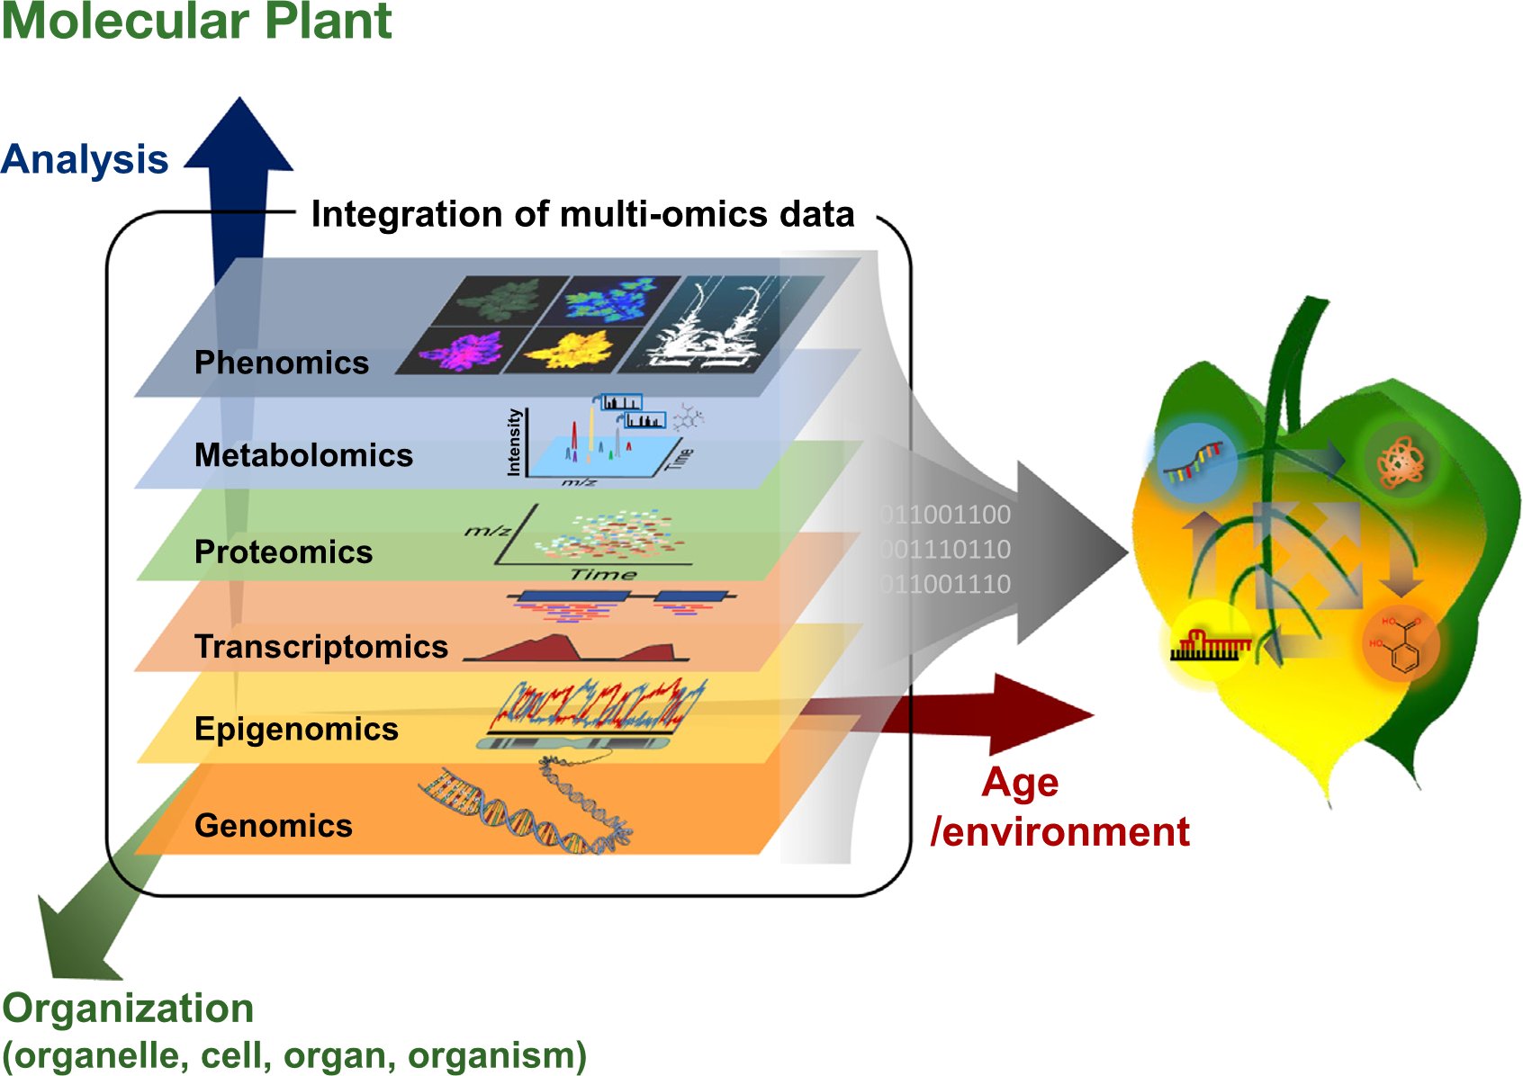






Data integration: a ubiquitous problem
Data sharing across government
Health
System Data
Census Data
Multi-omics data for biological research
Tax Data
Social Security Data
Enterprise information integration
CRM
ERP
SCM
Flat files
Kim et al. (2016). DOI: 10.1016/j.molp.2016.04.017

Slide 4
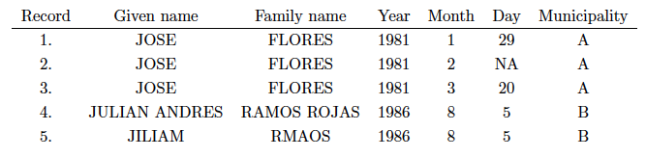
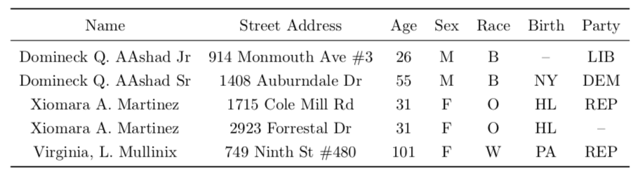
Human Rights Databases
Data sharing across government
Health
System Data
Census Data
Tax Data
Social Security Data
Patent and Author Disambiguation Databases
Voter Registration Databases

Slide 5

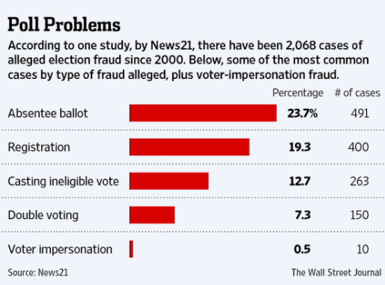

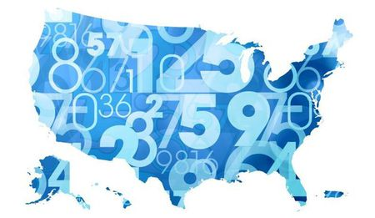

Slide 6
Human Rights Databases
Voter Registration Databases

Slide 7
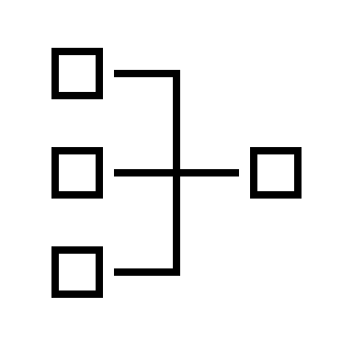
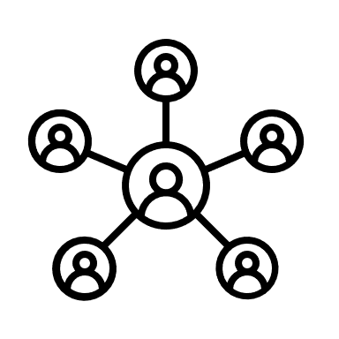


Key steps in data integration
Schema alignment
Entity resolution
Canonicalization
Map source schemas to a mediated schema
Identify records that refer to the same entity
Merge records that refer to the same entity
Data sources
Integrated data

Slide 9
Schema alignment
Entity resolution
Canonicalization
Map source schemas to a mediated schema
Identify records that refer to the same entity
Merge records that refer to the same entity
Data sources
Integrated data
Integrated data

Slide 10
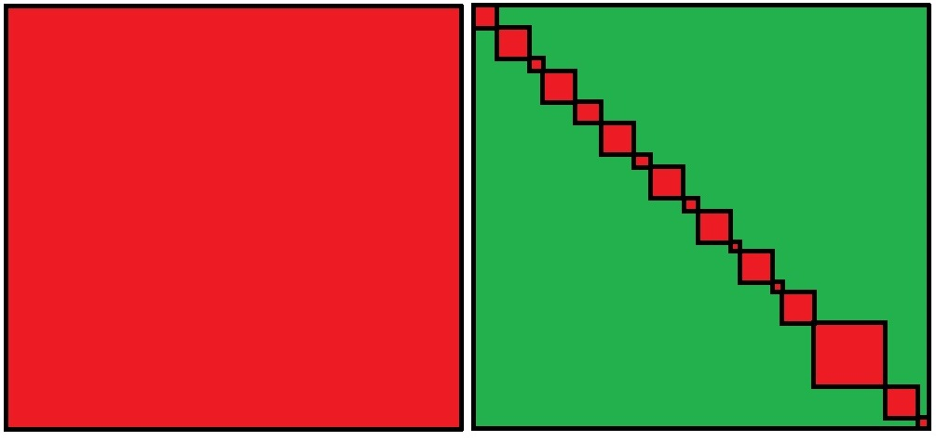
Schema alignment
Blocking
Entity resolution
Canonicalization
Map source schemas to a mediated schema
Place similar records into partitions
Identify records that refer to the same entity
Merge records that refer to the same entity
given_name
+ surname
full_name
full_name
Integrated data
Data sources

Slide 11
Focus of my thesis Statistical methods for entity resolution
Source 1
Source 2
Maria Luisa Santos
Santa Ana
· · ·
Maria Santos
Santa Ana
· · ·
Match?
Challenging without unique identifiers
Also known as: record linkage, data matching, merge/purge, deduplication
Statistical approach due to Fellegi & Sunter (1969) still widely used today
Other methods include: supervised machine learning, probabilistic graphical models, distance-based clustering, human-in-the-loop methods, rule-based methods etc.

Slide 12




Pain points for entity resolution
Costly manual labelling
Scalability/computational efficiency
Vast amounts of manually-labelled data are typically required for supervised learning and evaluation.
Approximations are required to avoid quadratic scaling. Need to ensure impact on accuracy is minimal.
Limited treatment of uncertainty
Unreliable evaluation
Given inherent uncertainties, it’s important to output predictions with confidence regions.
Standard evaluation methods return imprecise estimates of performance.

Slide 13
Contributions of my thesis
Scalable unsupervised Bayesian ER
Modelling improvements for unsupervised Bayesian ER
A theoretical framework for label-efficient evaluation
Adaptive labelling policies and empirical study
Costly manual labelling
Scalability/computational efficiency
Limited treatment of uncertainty
Unreliable evaluation

Slide 14
1. Scalable unsupervised Bayesian ER
N. G. Marchant, A. Kaplan, D. N. Elazar, B. I. P. Rubinstein and R. C. Steorts. “d-blink: Distributed End-to-End Bayesian Entity Resolution.” 2019. Under review at J. Comp. Graph. Stat.

Slide 15
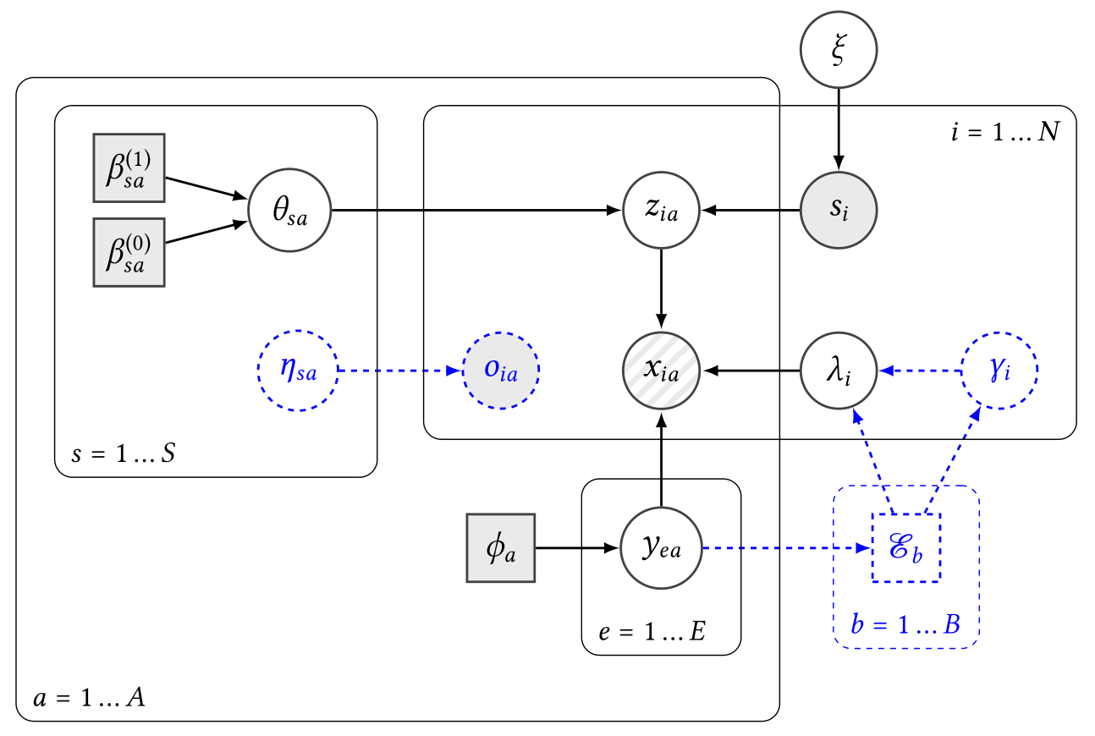
Why Bayesian models?
They tend to be data-efficient
Model encodes constraints and prior beliefs about the generative process
Apply Bayes’ rule to update beliefs about unknown parameters (i.e. coreference relation), conditional on observed data
Distributions represent uncertainty in beliefs

Slide 16
blink ER model
Entity model
Proposed by Steorts (2015)
Key features:
Assumes records are generated by sampling from a population of latent entities
Record attributes may be distorted (e.g. typos) when copied from the entity
Supports multiple structured data sources
Predicted coreference relation is transitive (no conflicts)
Problem: difficulty scaling beyond ~1000 records
Linkage/clustering model
Distortion model
Kimberley
Brown
12/30/1974
Kim
Brown
12/30/1974

Slide 17
Can we scale blink to 1 million records?
Current state of affairs:
Gibbs sampling is used for inference
Gibbs update for the entity assignments scales roughly quadratically in the # records
Need to run for many iterations (e.g. 100,000)
Steorts (2016) and others scale by partitioning the data and running inference separately in each block
We propose d-blink:
Computational speed-ups:
Incorporate probabilistic blocking
Sub-quadratic entity assignment update via indexing
Perturbation sampling for entity attribute update
Distributed/parallel inference
Partially-collapsed Gibbs sampling for improved statistical efficiency
Also add support for:
missing values
arbitrary attribute similarity functions

Slide 18
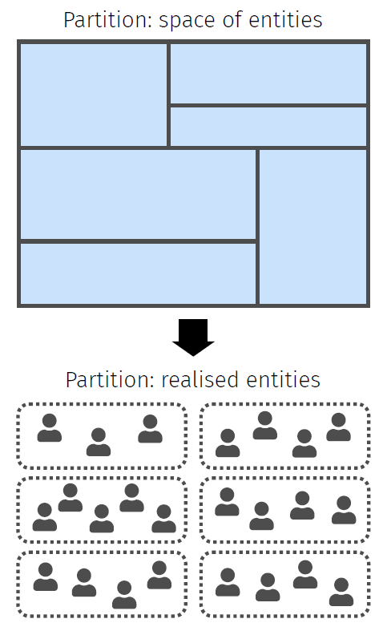
Auxiliary blocks
Partition the space of entities into blocks using a user-specified blocking function
Modify the model so that a record is first assigned to a block, then an entity within the block
By doing this modification carefully, we can ensure the marginal posterior is preserved
Asymptotically, inferred parameters are the same as for the original blink model
Also, enables distributed/parallel inference at the block-level

Slide 19
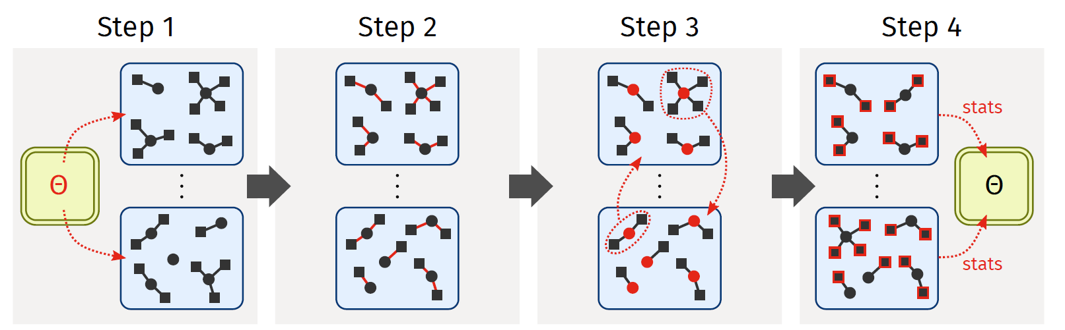
Distributed inference
Records/entities are conditionally independent across blocks
Update distortion probs on the manager and broadcast to the workers
Update entity assignments on the workers. Records may only be assigned to entities within their block.
Update entity attributes and block assignments on the workers. Move the entities and records to their newly-assigned blocks.
Update distortion indicators, then calculate summary stats on the worked. Broadcast to the manager.

Slide 20

Experiments
Open-source implementation in Apache Spark
Tested on local server + Amazon EMR
Five synthetic/publicly-available data sets
Comparison with 3 baseline methods
Recent application to population enumeration using U.S. 2010 Decennial Census + admin records from the U.S. Social Security Administration
Data set | Description | Num. records | Num. sources | Num. entities
ABSEmployee | Synthetic employee data | 600,000 | 3 | 400,000
NCVR | Voter records | 448,134 | 2 | 296,433
NLTCS | Longitudinal health survey | 57,077 | 3 | 34,945
SHIW0810 | Longitudinal survey | 39,743 | 2 | 28,584
RLdata10000 | Synthetic personal data | 10,000 | 1 | 9,000

Slide 21
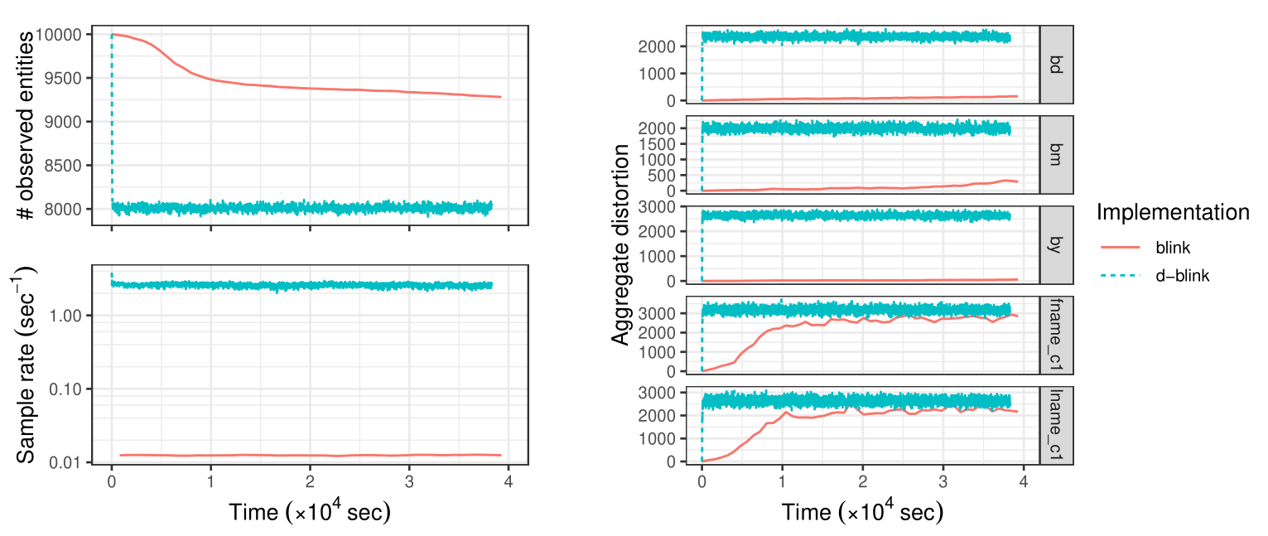
Experimental results Convergence and efficiency of d-blink versus blink
200× speed-up

Slide 22
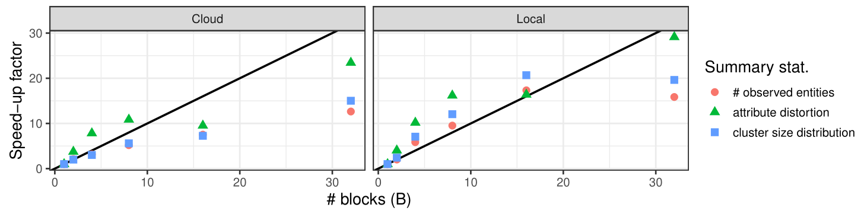
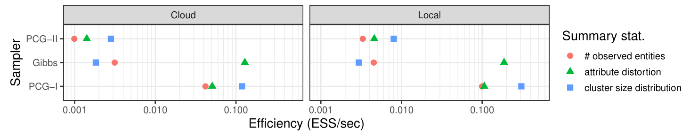
Experimental results Efficiency gains due to blocking and PCG sampling
Near-linear speed-up
20-100× speed-up

Slide 23
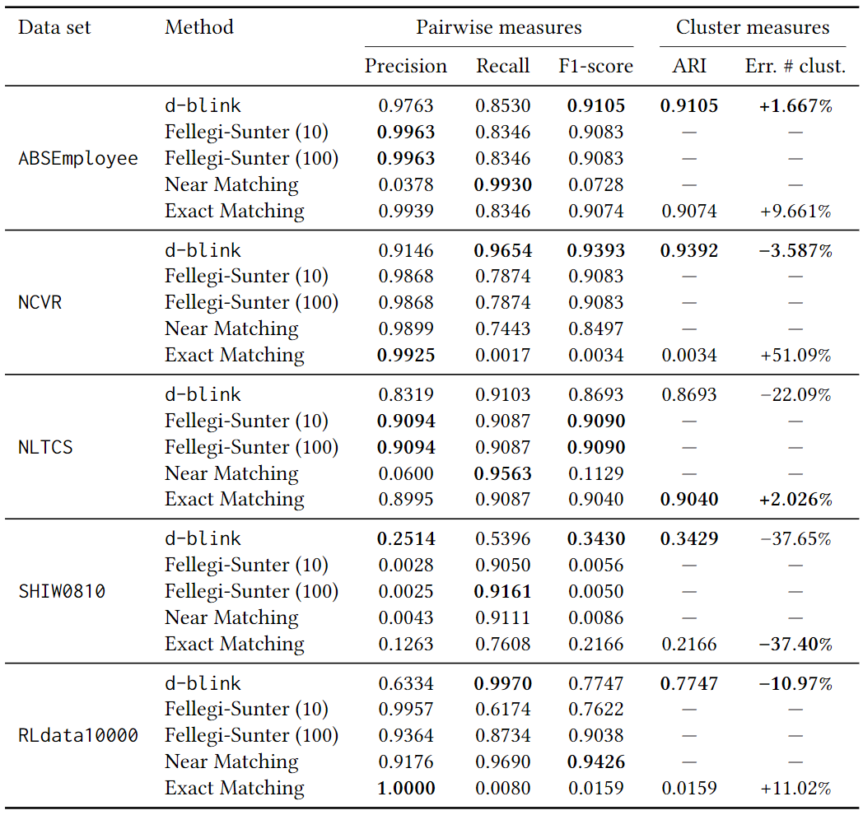
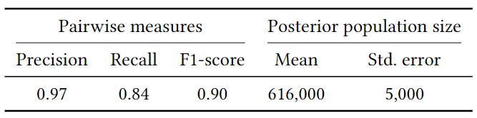
Experimental results Linkage quality
Competitive ER accuracy on data sets tested
Observed sensitivity to hyperparameters (results not shown)
Census/Numident results

Slide 24
Summary
Achieved a significant speed-up, e.g. by a factor of 300×
All of our ideas contributed to the speed-up: blocking, partially-collapsed Gibbs sampling, fast algorithms for Gibbs updates, parallelisation
d-blink is promising for ER of moderately-sized data (~1 million records)
Future work:
Variational Bayes as an alternative to MCMC
Modelling improvements
Semi-supervised setting

Slide 25
2. A refined model for unsupervised Bayesian ER
N. G. Marchant, B. I. P. Rubinstein and R. C. Steorts. “Exchangeable clustering priors for Bayesian entity resolution.” 2020. Working paper

Slide 26
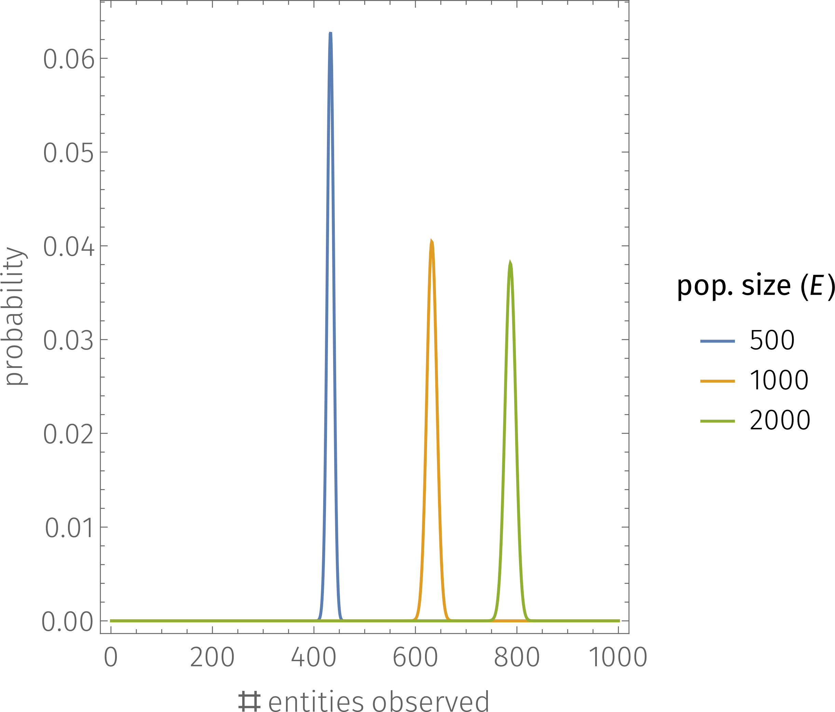
Can we improve the blink ER model?
Criticisms:
Several parameters are set empirically
Informative priors
Sensitivity to hyperparameters
Inferred level of distortion tends to be unreasonably high

Slide 27
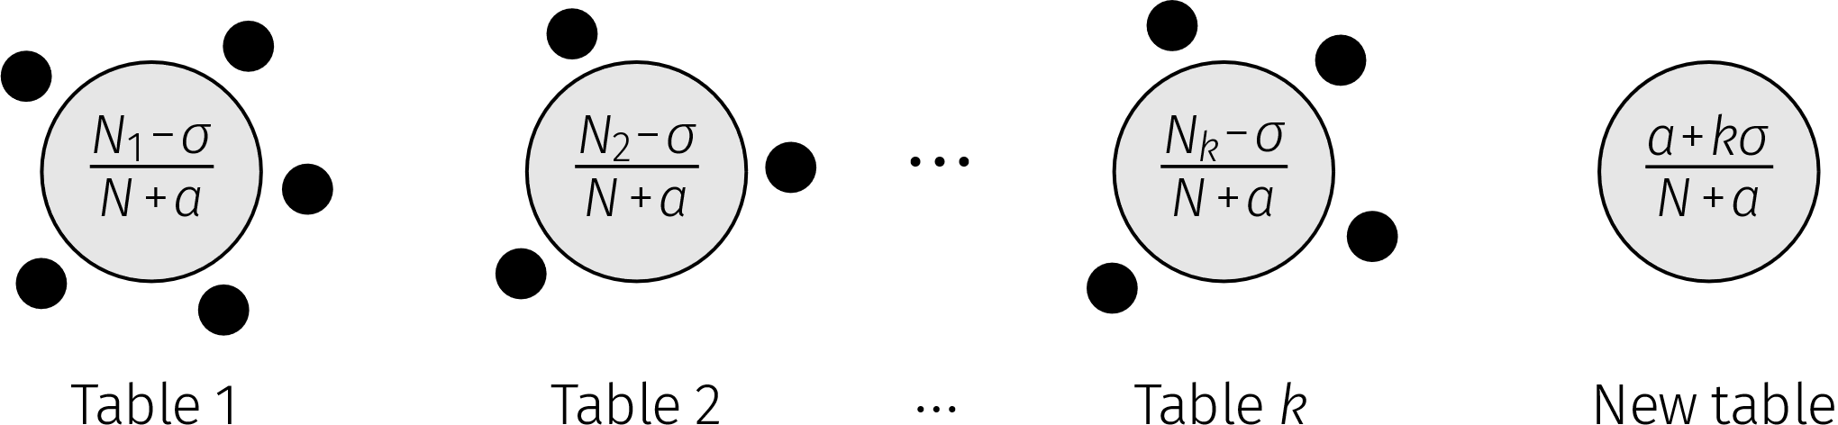
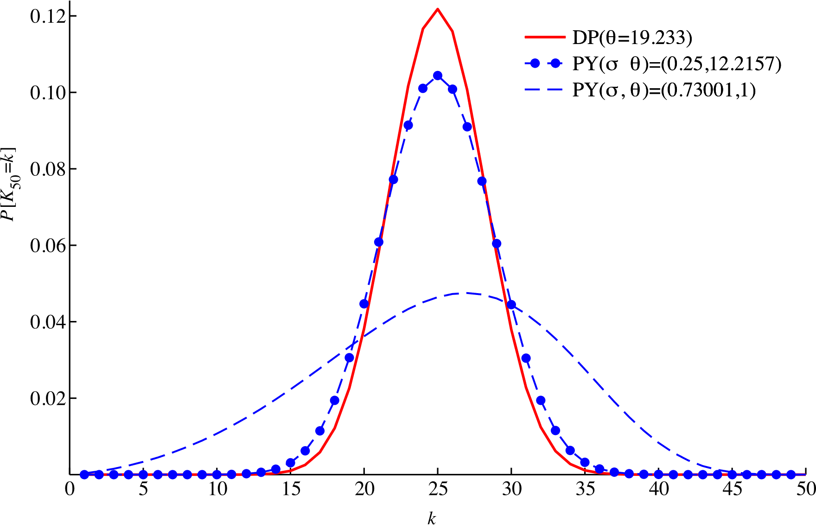
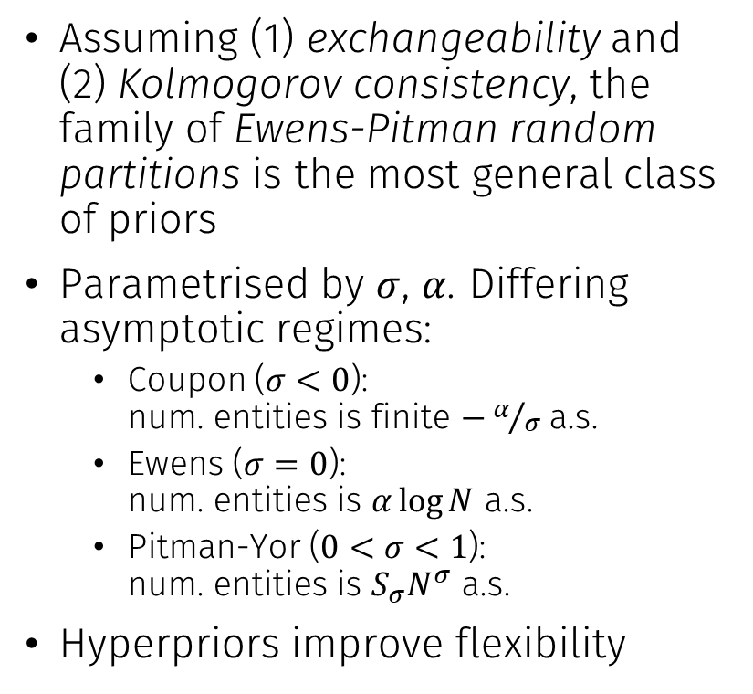
Flexible priors on the linkage structure
Assuming (1) exchangeability and (2) Kolmogorov consistency, the family of Ewens-Pitman random partitions is the most general class of priors
Parametrised by $σ$, $α$. Differing asymptotic regimes:
Coupon ($σ<0$): num. entities is finite $−α/σ$ a.s.
Ewens ($σ=0$): num. entities is $α\log{N}$ a.s.
Pitman-Yor ($0<σ<1$): num. entities is $S_{σ}N^{σ}$ a.s.
Hyperpriors improve flexibility

Slide 28


Other improvements
Corrected distortion model
Make the probability of distortion depend on the entity attribute
If a record attribute is “distorted” it must differ from the entity attribute
Deepen the model
Place Dirichlet process priors on:
the entity attribute distribution (generates an entity attribute)
the distortion distribution (generates a distorted record value conditional on the entity attribute value)
These were set empirically in blink
Kimberley
Bytheseashore
12/30/1974
Kim
Bytheseashore
12/30/1974
Distorted
Distorted
Not distorted

Slide 29
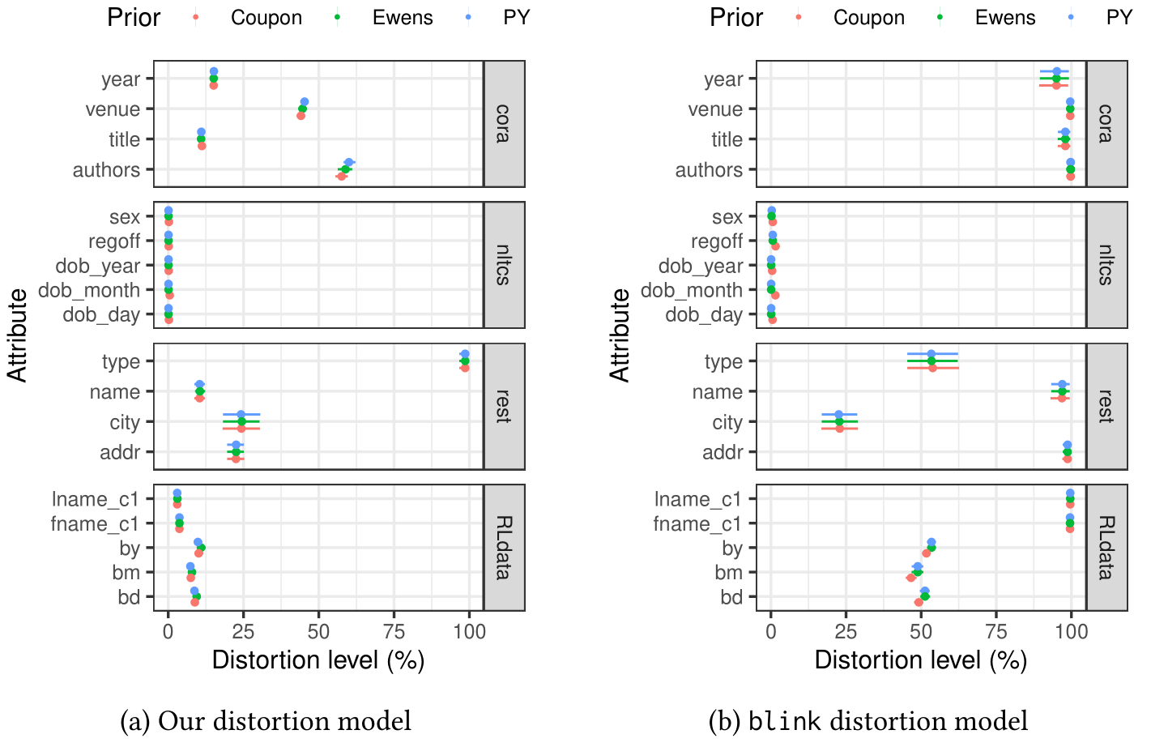
Experimental results Effect of the distortion model
Inferred level of distortion is now consistent with expectations
ER quality also improved: less susceptible to over-linkage
Our distortion model
blink distortion model

Slide 30
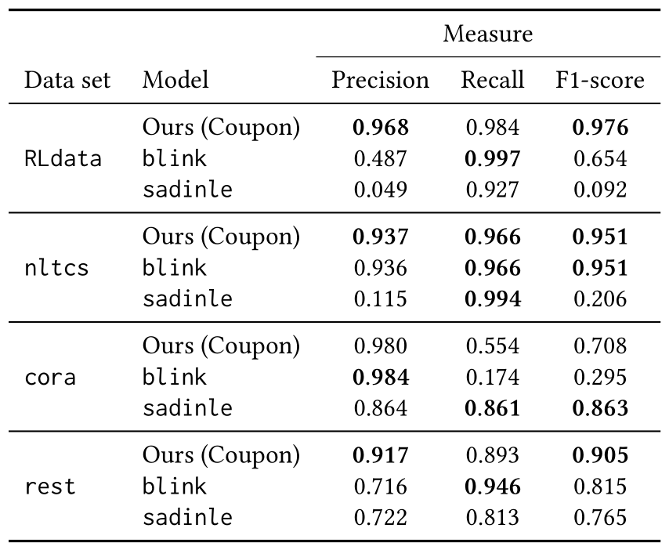
Experimental results Comparison against baseline methods
Compared our refined model against:
blink (Steorts, 2015)
sadinle (Sadinle, 2014) which is an extension of Fellegi & Sunter (1969)
Observe a significant improvement over blink
More detailed experiments indicate that both changes (flexible prior on the linkage structure + corrected distortion model) play a role

Slide 31
3. A theoretical framework for label-efficient evaluation
N. G. Marchant and B. I. P. Rubinstein. “A general framework for label-efficient online evaluation with asymptotic guarantees.” 2020. Submitted to NeurIPS’20.

Slide 32
Challenges for evaluation of ER
Source 𝒟₁
Source 𝒟₂
Evaluation is essential for ER workflows:
System tuning
Benchmarking
Ensuring performance standards are met
Standard principled approach:
Sample pairs of records uniformly at random
Ask humans to label as match/non-match
Compute performance measures from the sample
Pool of record pairs from 𝒟₁× 𝒟₂
Imbalance problem:
For every match, there are roughly max(|𝒟₁|,|𝒟₂|) non-matches ⇒ need a huge labelled sample to get a precise performance estimate.

Slide 33
A snapshot of related work
Variance reduction methods for evaluation:
Static importance sampling (Sawade et al., 2010; Schnabel et al., 2016)
Stratified sampling (Druck & McCallum, 2011)
Online stratified sampling (Bennett & Carvalho, 2010)
These haven’t been applied to ER
Several limitations:
Lack of support for a broad range of performance measures
Lack of support for evaluating multiple systems/measures in parallel
Lack of support for interactive (adaptive) evaluation
Limited efficiency (stratified sampling)

Slide 34
An AIS-based evaluation framework
We propose a framework based on adaptive importance sampling (AIS)
Labels are collected in rounds by querying an oracle (e.g. human annotator)
The labelling policy (which selects items to label) is adapted based on labels collected in previous rounds
Performance estimates are bias-corrected

Slide 35
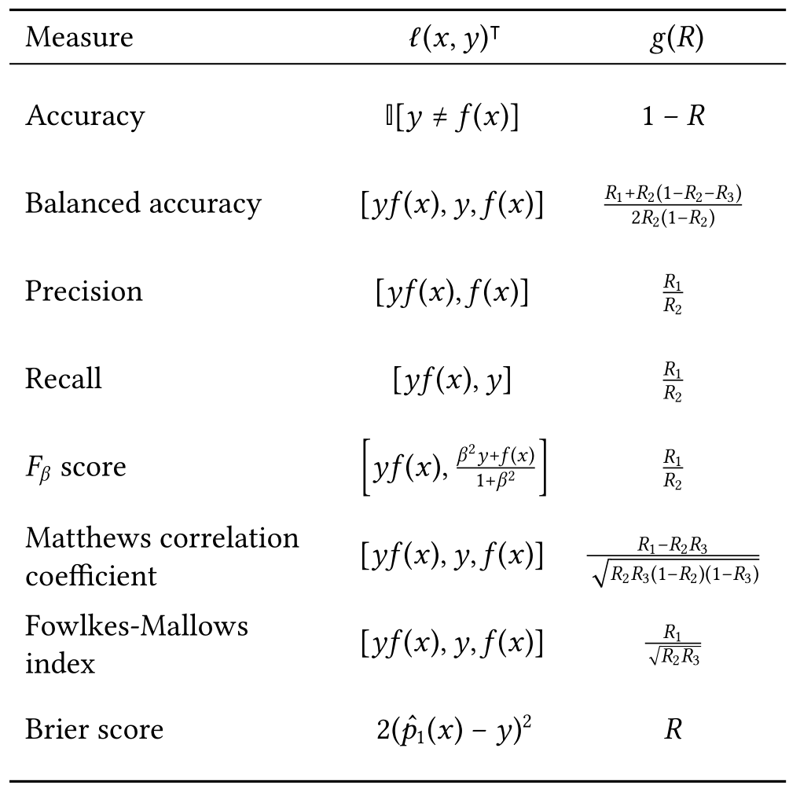
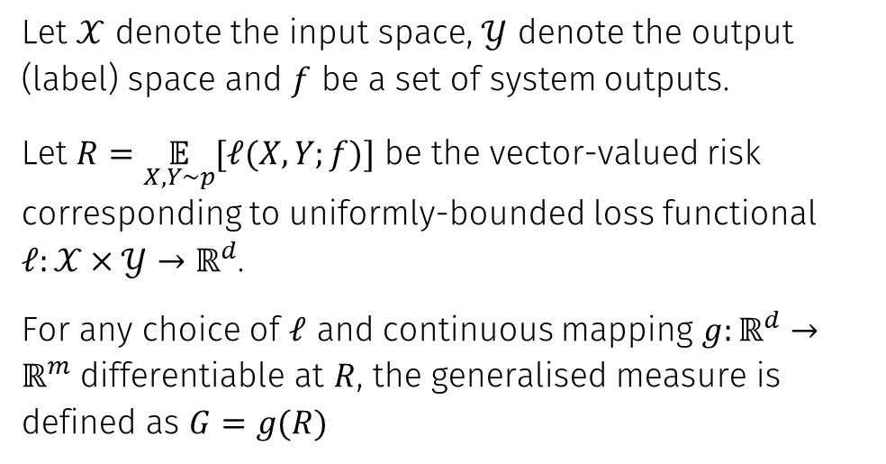
Which performance measures are covered?
We consider a family of generalised measures which corresponds to transformations of vector-valued risk functionals.
Let $𝒳$ denote the input space, $𝒴$ denote the output (label) space and $f$ be a set of system outputs.
Let $R=\underset{X,Y∼p}{𝔼}{[ℓ(X,Y;f)]}$ be the vector-valued risk corresponding to uniformly-bounded loss functional $ℓ:𝒳×𝒴→ℝ^{d}$.
For any choice of $ℓ$ and continuous mapping $g:ℝ^{d}→ℝ^{m}$ differentiable at $R$, the generalised measure is defined as $G=g(R)$

Slide 36
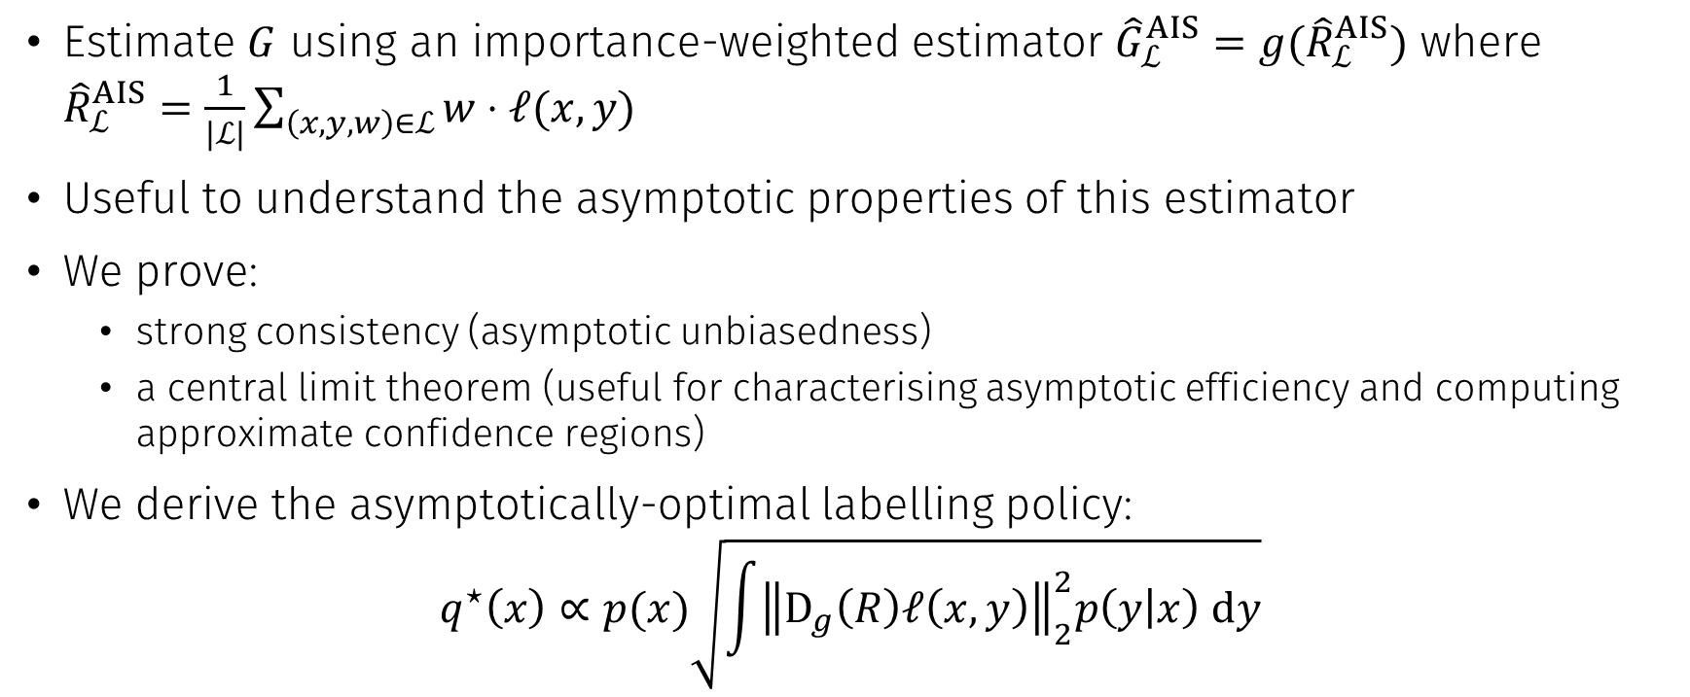
Asymptotic theory
Estimate $G$ using an importance-weighted estimator ${\hat{G}}_{ℒ}^{AIS}=g({\hat{R}}_{ℒ}^{AIS})$ where ${\hat{R}}_{ℒ}^{AIS}=\frac{1}{|ℒ|}\sum_{\left(x,y,w\right)∈ℒ}{w⋅ℓ(x,y)}$
Useful to understand the asymptotic properties of this estimator
We prove:
strong consistency (asymptotic unbiasedness)
a central limit theorem (useful for characterising asymptotic efficiency and computing approximate confidence regions)
We derive the asymptotically-optimal labelling policy:
$$q^{⋆}\left(x\right)∝p(x)\sqrt{\int{{\left\|D_{g}\left(R\right)ℓ\left(x,y\right)\right\|}_{2}^{2}p\left(y | x\right) dy}}$$

Slide 37
4. Adaptive labelling policies for evaluation
N. G. Marchant and B. I. P. Rubinstein. “A general framework for label-efficient online evaluation with asymptotic guarantees.” 2020. Submitted to NeurIPS’20.
N. G. Marchant and B. I. P. Rubinstein. “In Search of an Entity Resolution OASIS: Optimal Asymptotic Sequential Importance Sampling.” 2017. Appeared at VLDB’17.

Slide 38
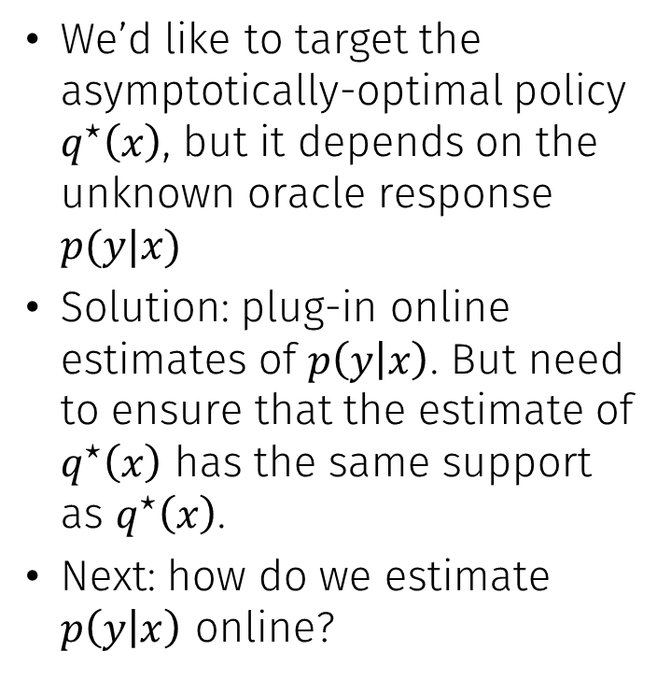
How to adapt the labelling policy?
We’d like to target the asymptotically-optimal policy $q^{⋆}\left(x\right)$, but it depends on the unknown oracle response $p(y|x)$
Solution: plug-in online estimates of $p\left(y | x\right)$. But need to ensure that the estimate of $q^{⋆}\left(x\right)$ has the same support as $q^{⋆}\left(x\right)$.
Next: how do we estimate $p\left(y | x\right)$ online?

Slide 39
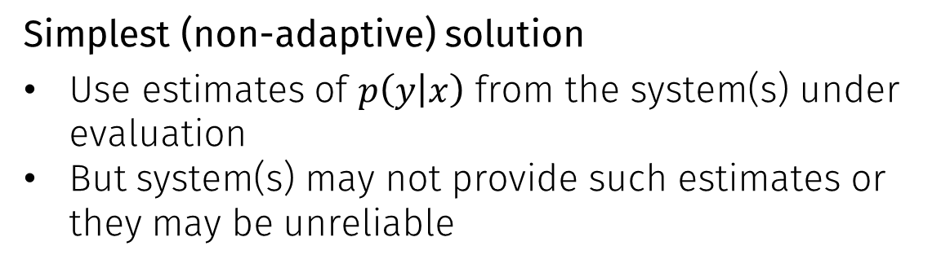
Estimating the oracle response
x
Simplest (non-adaptive) solution
Use estimates of $p\left(y | x\right)$ from the system(s) under evaluation
But system(s) may not provide such estimates or they may be unreliable
Our proposal
Use a Bayesian model
Use the system(s) under evaluation to set the prior
Update estimates as labels are observed
p(y|x)?

Slide 40
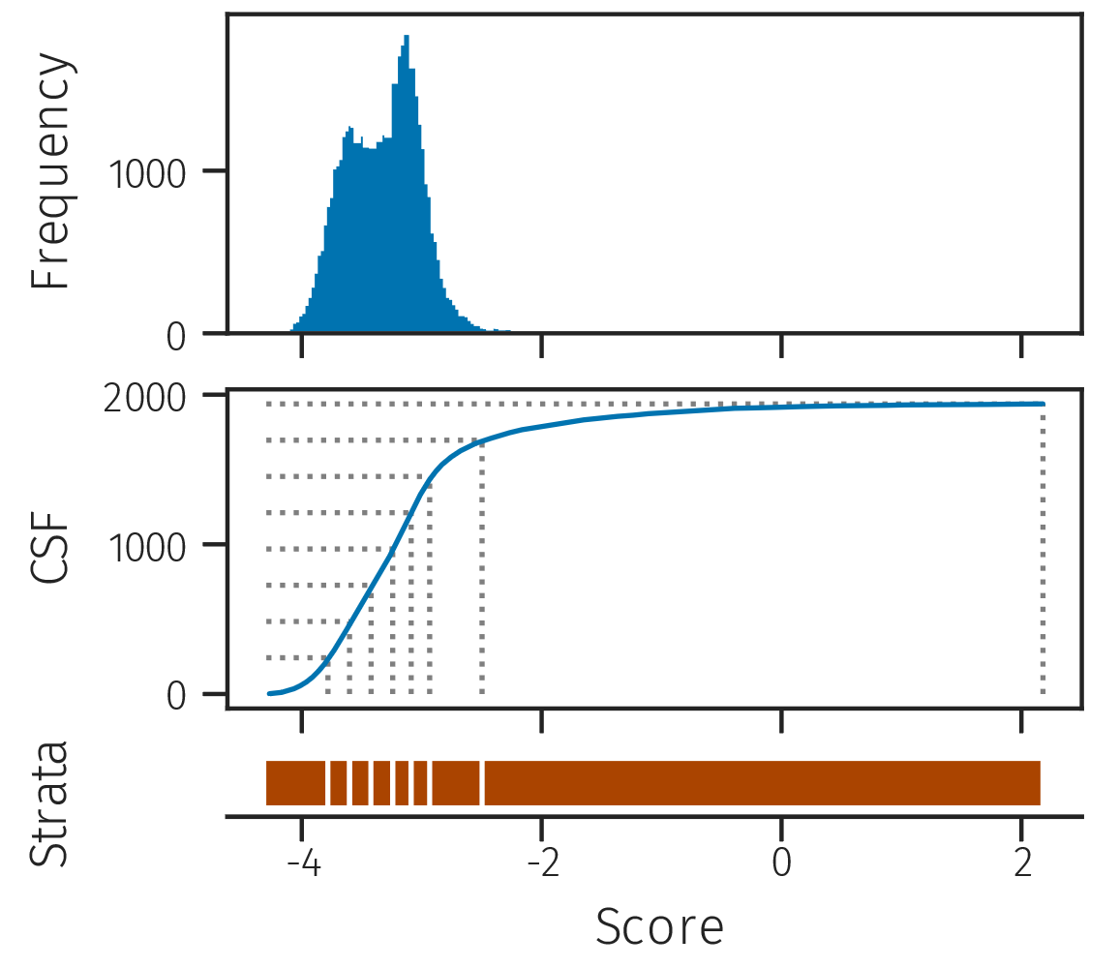
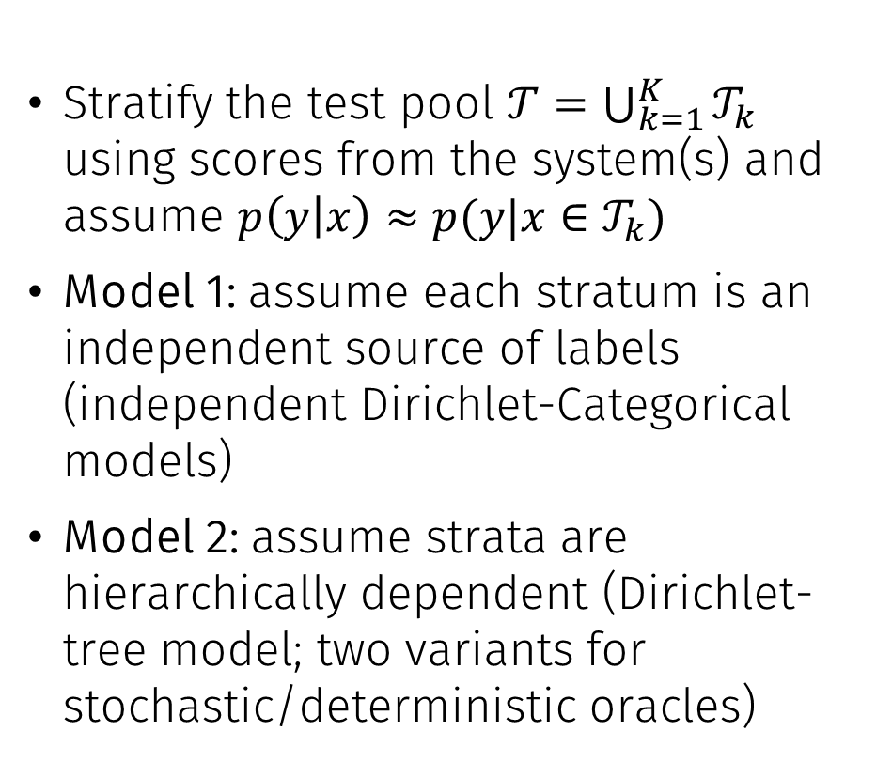
Bayesian model for the oracle response
Stratify the test pool $𝒯=\bigcup_{k=1}^{K}{𝒯_{k}}$ using scores from the system(s) and assume $p\left(y | x\right)≈p(y|x∈𝒯_{k})$
Model 1: assume each stratum is an independent source of labels (independent Dirichlet-Categorical models)
Model 2: assume strata are hierarchically dependent (Dirichlet-tree model; two variants for stochastic/deterministic oracles)

Slide 41
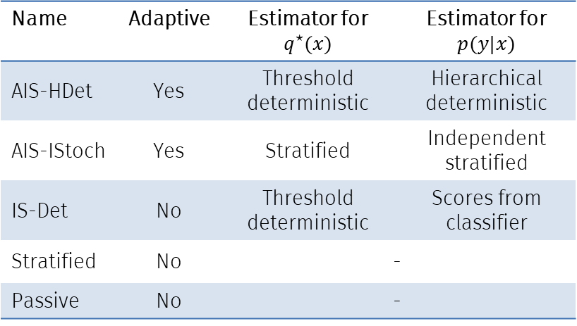
Experiments
Implemented as open-source Python package called activeeval
4 ER data sets (highly imbalanced) + 3 non-ER data sets
5 evaluation methods
Data sets
Evaluation methods
Data set | Size | Imb. ratio | Classifier | True F1
abt-buy | 53,753 | 1075 | SVM | 0.595
amzn-goog | 676,267 | 3381 | SVM | 0.282
dblp-acm | 53,946 | 2697 | SVM | 0.947
restaurant | 149,747 | 3328 | SVM | 0.899
safedriver | 178,564 | 26.56 | XGB | 0.100
creditcard | 85,443 | 580.2 | LR | 0.728
tweets100k | 20,000 | 0.990 | SVM | 0.770
Name | Adaptive | Estimator for $q^{⋆}(x)$ | Estimator for $p(y|x)$
AIS-HDet | Yes | Threshold deterministic | Hierarchical deterministic
AIS-IStoch | Yes | Stratified | Independent stratified
IS-Det | No | Threshold deterministic | Scores from classifier
Stratified | No | -
Passive | No | -

Slide 42
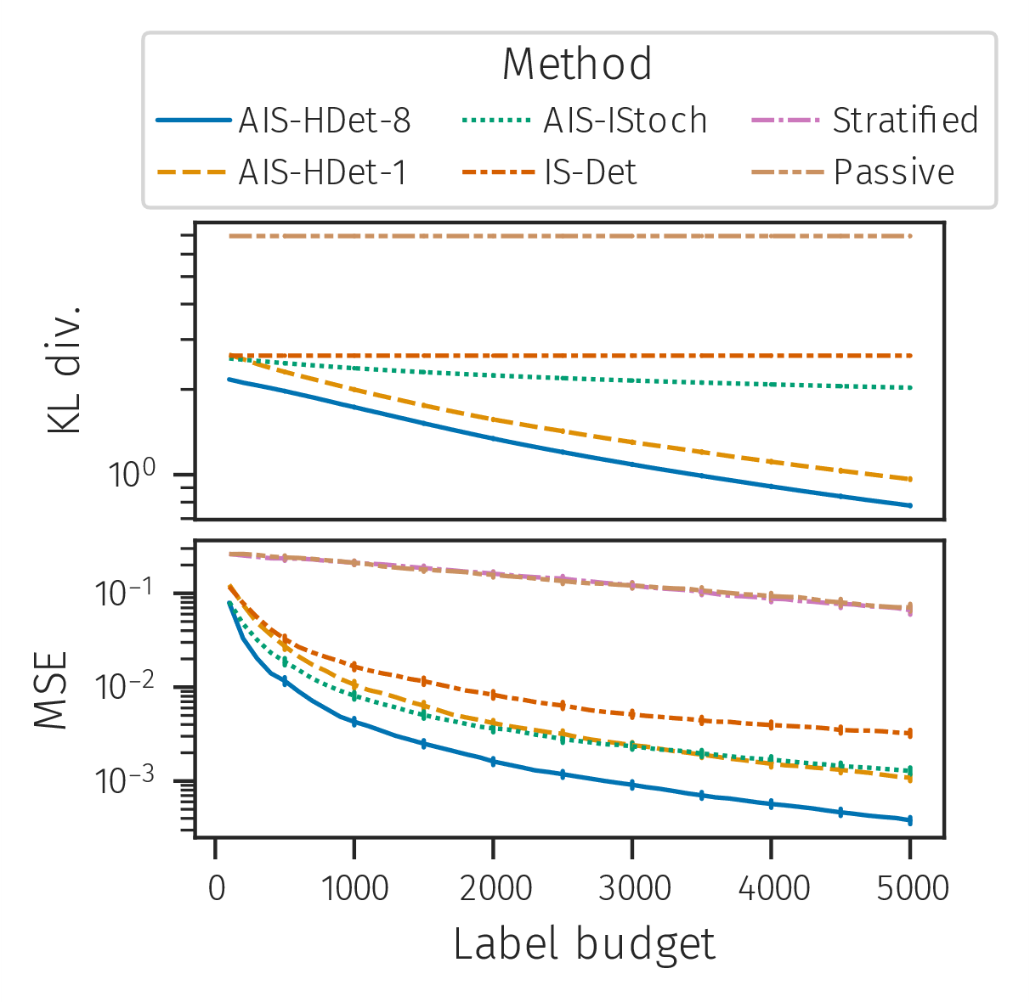
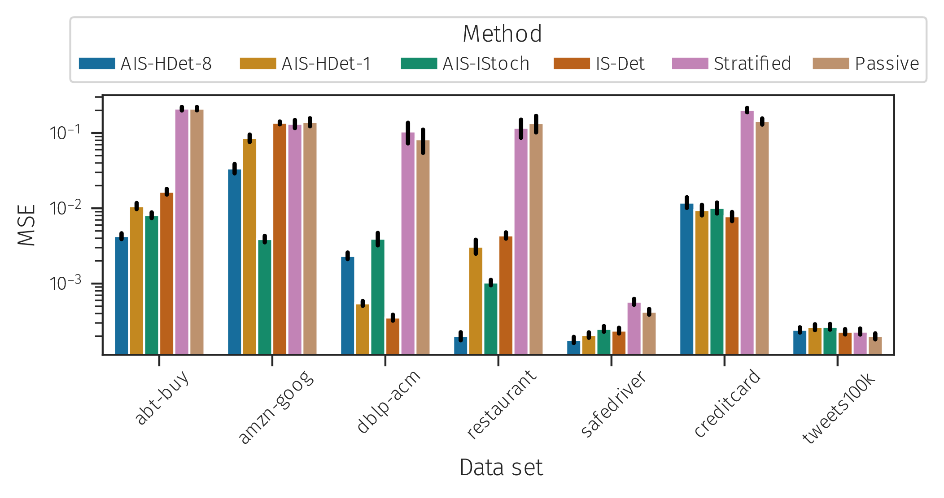
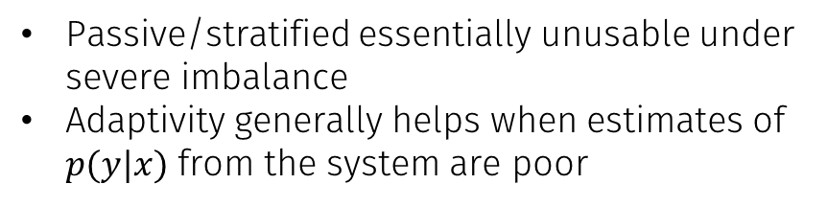
Selected results
Passive/stratified essentially unusable under severe imbalance
Adaptivity generally helps when estimates of $p(y|x)$ from the system are poor
MSE of estimated F1-score (over 1000 repeats) assuming a label budget of 1000
Convergence of estimated F1-score (over 1000 repeats) for abt-buy

Slide 43
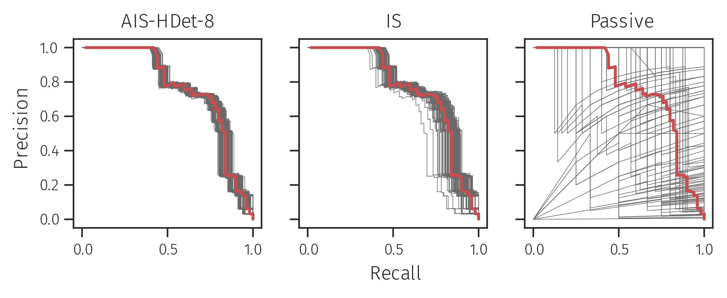
Selected results
We can also estimate vector-valued measures using our framework
Again, passive sampling is essentially unusable
A sample of 100 estimated precision-recall curves for abt-buy assuming a label budget of 5000. The red curve is the unknown true curve.

Slide 44
Summary
Developed a statistically-grounded framework for evaluation with asymptotic guarantees
Increased statistical precision means
practitioners can be more confident in evaluation results
fewer labels are required
Future work
Non-asymptotic theory (Akyildiz and Míguez, 2019)
Integration with crowdsourcing methods

Slide 45
Conclusion

Slide 46
Summary of contributions
Statistical approaches for performing and evaluating ER
Scalable and efficient inference for Bayesian ER
Modelling improvements for Bayesian ER: reduced sensitivity and improved accuracy
A statistical framework for evaluation with asymptotic guarantees
Adaptive labelling policies for the evaluation framework
no cost for manual labelling, proper handling of uncertainty
reduced cost of manual labelling, improved reliability of evaluation
Open-source software published at github.com/ngmarchant and github.com/cleanzr

Slide 47
Thanks
Thanks to all who have supported me during my PhD
Special thanks to
My supervisors: Ben Rubinstein, Beka Steorts and Aurore Delaigle
My co-authors: Daniel Elazar and Andee Kaplan
Chair of my advisory committee: Reeva Lederman
Australian Bureau of Statistics for funding support

Slide 48
Appendices

Slide 49
Key references: Bayesian ER
Fellegi, I. P., & Sunter, A. B. (1969). A theory for record linkage. Journal of the American Statistical Association, 64(328), 1183-1210.
Steorts, R. C. (2015). Entity resolution with empirically motivated priors. Bayesian Analysis, 10(4), 849-875.
Steorts, R. C., Hall, R., & Fienberg, S. E. (2016). A Bayesian approach to graphical record linkage and deduplication. Journal of the American Statistical Association, 111(516), 1660-1672.
Sadinle, M. (2014). Detecting duplicates in a homicide registry using a Bayesian partitioning approach. The Annals of Applied Statistics, 8(4), 2404-2434.
Van Dyk, D. A., & Park, T. (2008). Partially collapsed Gibbs samplers: Theory and methods. Journal of the American Statistical Association, 103(482), 790-796.
Pitman, J. (1992). The two-parameter generalization of Ewens’ random partition structure. Technical Report 345, Dept. Statistics, UC Berkeley.
Betancourt, B., Zanella, G., Miller, J. W., Wallach, H., Zaidi, A., & Steorts, R. C. (2016). Flexible models for microclustering with application to entity resolution. In Advances in Neural Information Processing Systems (pp. 1417-1425).

Slide 50
Key references: Evaluation
Bennett, P. N., & Carvalho, V. R. (2010, October). Online stratified sampling: evaluating classifiers at web-scale. In Proceedings of the 19th ACM international conference on Information and knowledge management (pp. 1581-1584).
Druck, G., & McCallum, A. (2011, October). Toward interactive training and evaluation. In Proceedings of the 20th ACM international conference on Information and knowledge management (pp. 947-956).
Dennis III, S. Y. (1996). A Bayesian analysis of tree-structured statistical decision problems. Journal of statistical planning and inference, 53(3), 323-344.
Sawade, C., Landwehr, N., & Scheffer, T. (2010). Active estimation of F-measures. In Advances in Neural Information Processing Systems (pp. 2083-2091).
Portier, F., & Delyon, B. (2018). Asymptotic optimality of adaptive importance sampling. In Advances in Neural Information Processing Systems (pp. 3134-3144).

Slide 51
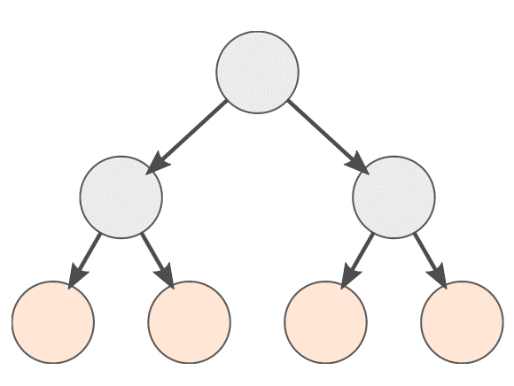
Blocking function
Desirable properties
Balanced: each block has equal probability mass under the distribution on entity attributes
Good separation: high similarity within a block, low similarity between blocks
k-d tree blocking function
Recursively partitions the space of entity attributes
Each node is associated with a binary splitting rule on one of the attributes
Use the empirical distribution from the observed records to approximate the distribution over the space

Slide 52
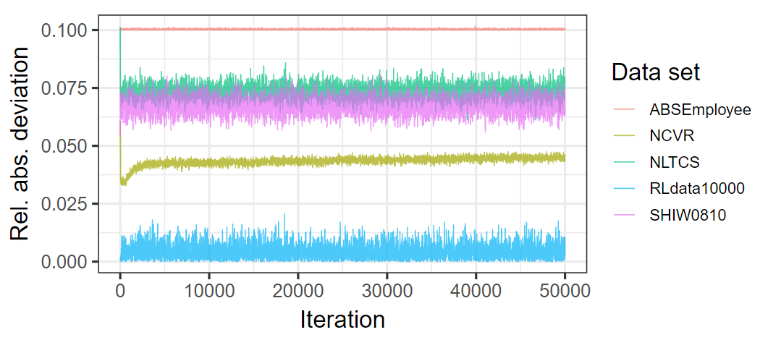
What about load balancing?
Measure the relative absolute deviation from the perfectly-balanced configuration along the Markov chain

Slide 53
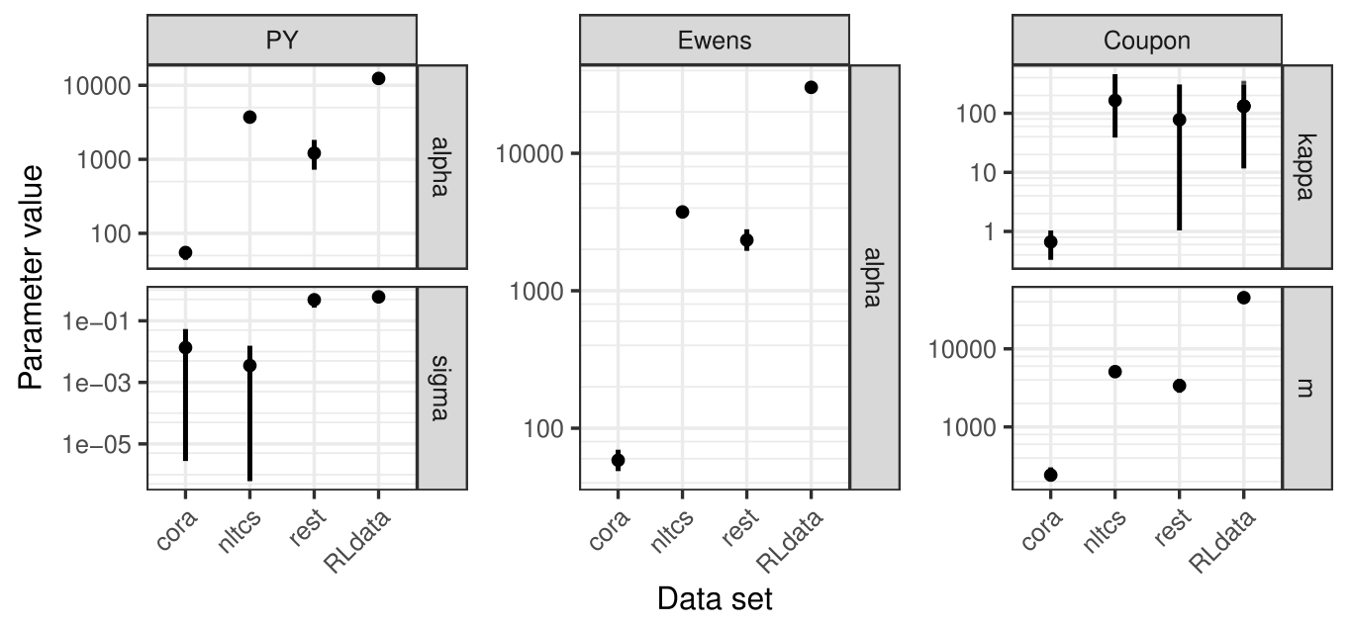
Ewens-Pitman parameters

Slide 54
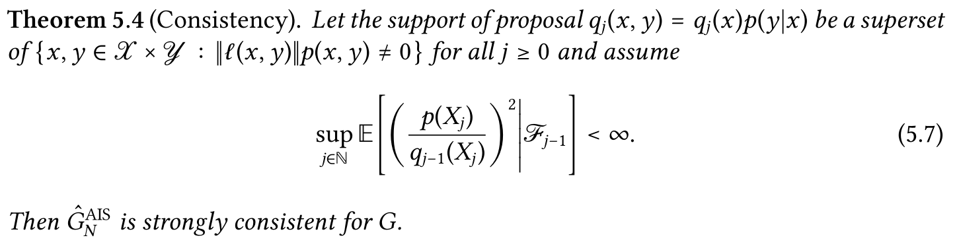
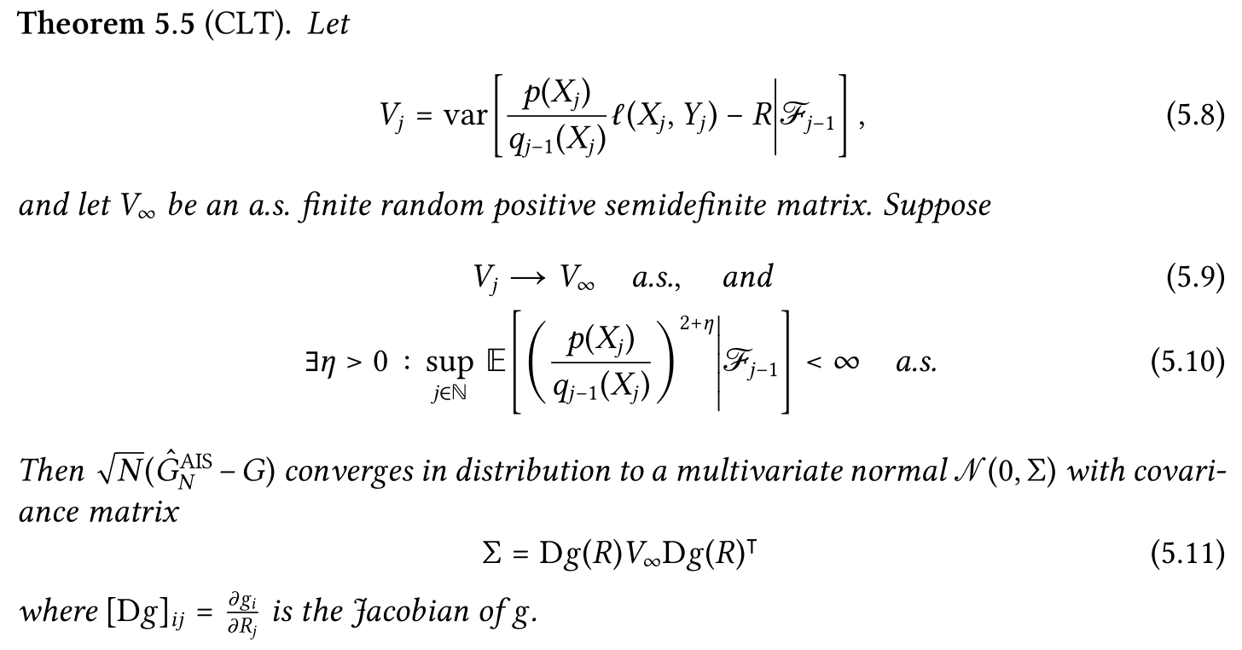
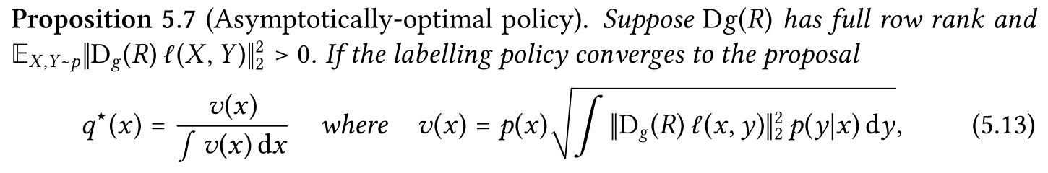
Theorems for evaluation framework

Slide 55
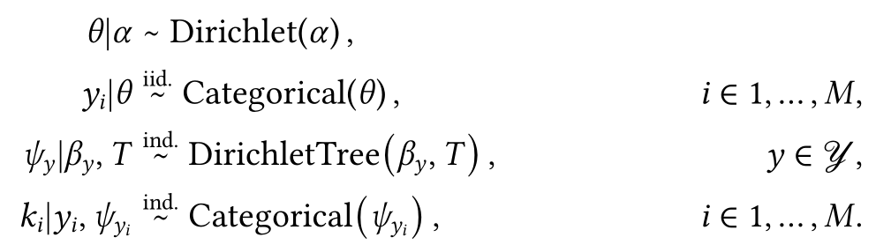
Dirichlet-tree model
Hierarchical
structure
𝒯1
𝒯2
𝒯3
𝒯4
𝒯5
𝒯6
𝒯7
𝒯8
Ordered strata

